Slide 1

Kabab & kofta Website Content

Slide 2
Home page Website Content

Slide 3

Slider section
header
paragraph
Width : 1600px
Height : 850px

Slide 4
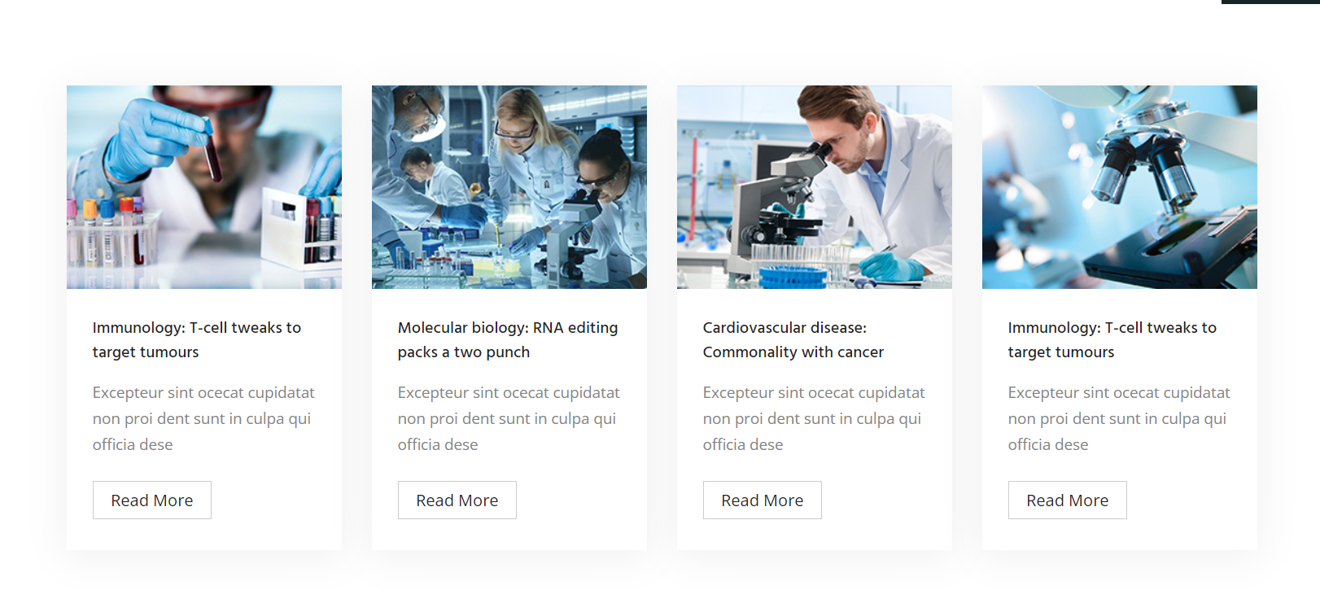
services
270w x 200h

Slide 5
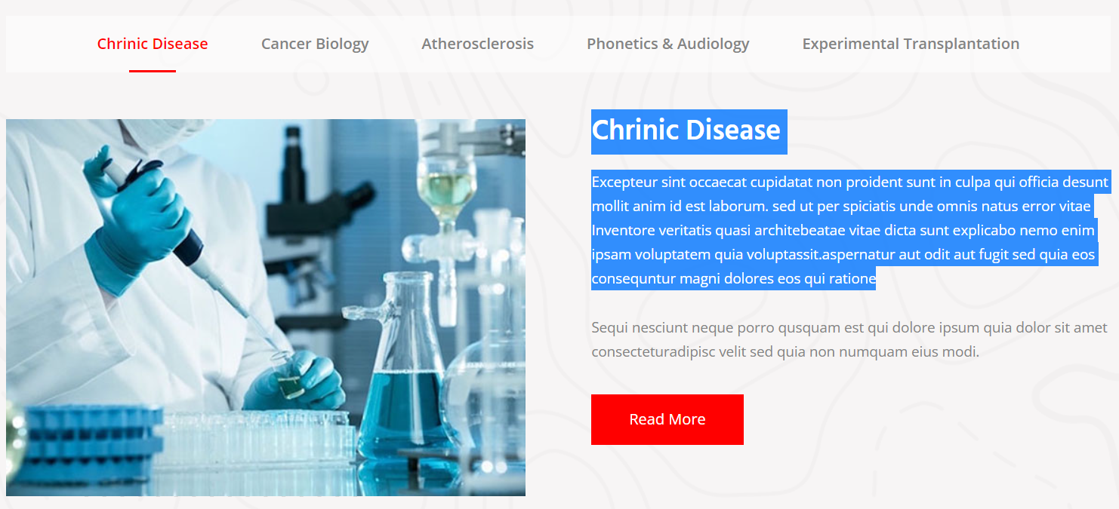
Lastest services
Category
Header
Paragraph
Image: 500 w x 400 h

Slide 6
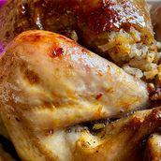
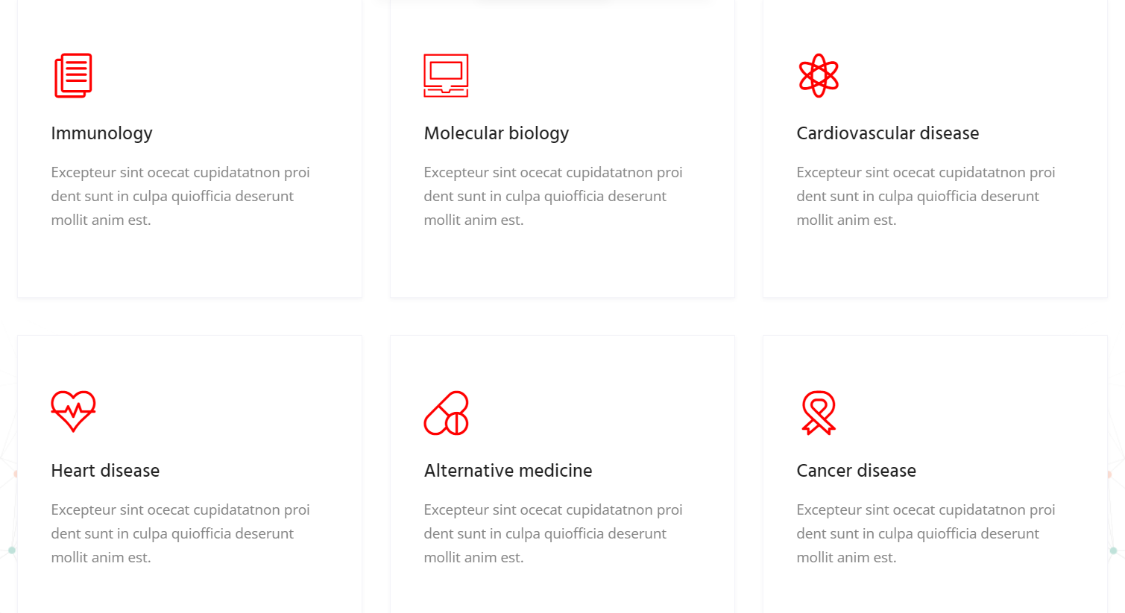
About cards

Slide 7

Contact us
Header
Width : 1920 height : 650

Slide 8

About section
Header
paragraph
Width : 540 height : 540

Slide 9
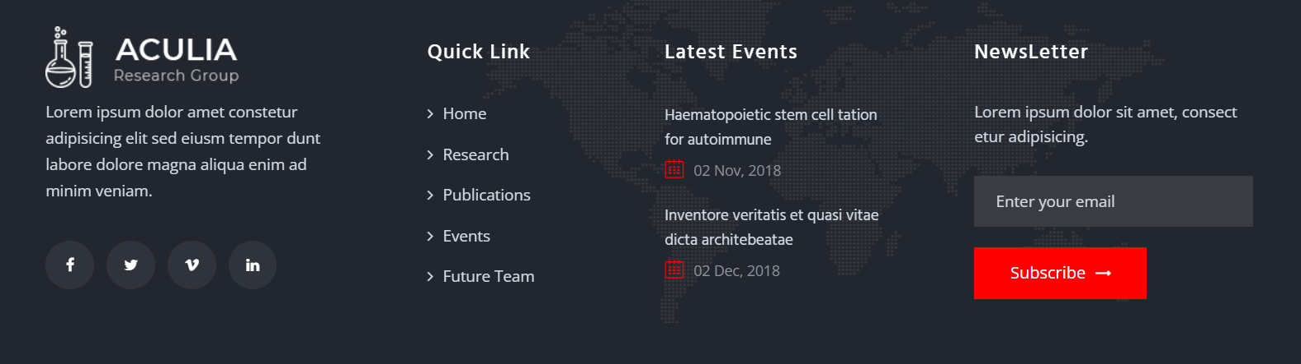
footer

Slide 10
About page Website Content

Slide 11

About us

Slide 12

About us banner
1920 w x 400 h

Slide 13

About us team
Image 270w x 370 h

Slide 14
About us vision and mission
Vision
Mission
Images 550 w x 400 h

Slide 15

counter
+15
+29837
+30
2
Years of experience
Satisfied Clients
Menu Items
Branches

Slide 16
services page Website Content

Slide 17

services
Icon or image for the service

Slide 18
banner page Website Content

Slide 19

Banner page
1920 w x 300 h

Slide 20
contact page Website Content

Slide 21
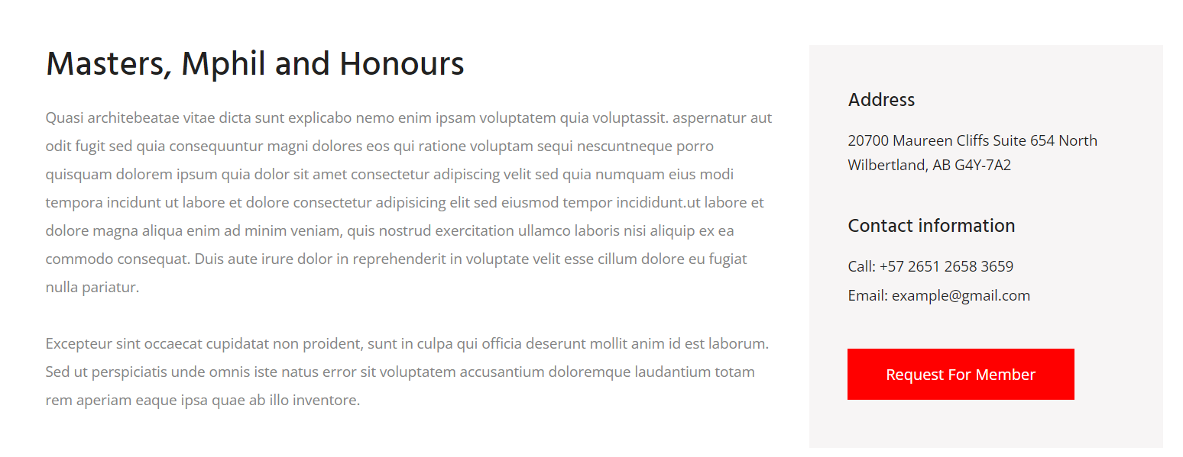
About us

Slide 22


